Slide 1

Autonomous Car Project
Büşra Nur BAHADIR 201511006
Advisor:
Assist. Prof. Dr. Roya CHOUPANI

Slide 2
Contents
Problem
Analysis
Solution
Results and Conclusion
References
Demo

Slide 3

Problem
Emergency vehicle priority is an important issue in the traffic. If we clear the way for emergency vehicles as quickly as possible, we can increase the survival rate of the patients or people on the emergency situations. Our project aiming to add vehicle priority awareness feature to autonomous cars.

Slide 4
Analysis
Five fundamental parts of autonomous cars:
Localization
Perception
Prediction
Planning
Control

Slide 5
Solution
Emitter Receiver sensors used on Emergency Car and Autonomous Car to provide communication between them to clear Emergency Vehicle’s way.
On the Project as simulator Webots and for programming Python has been used.

Slide 6
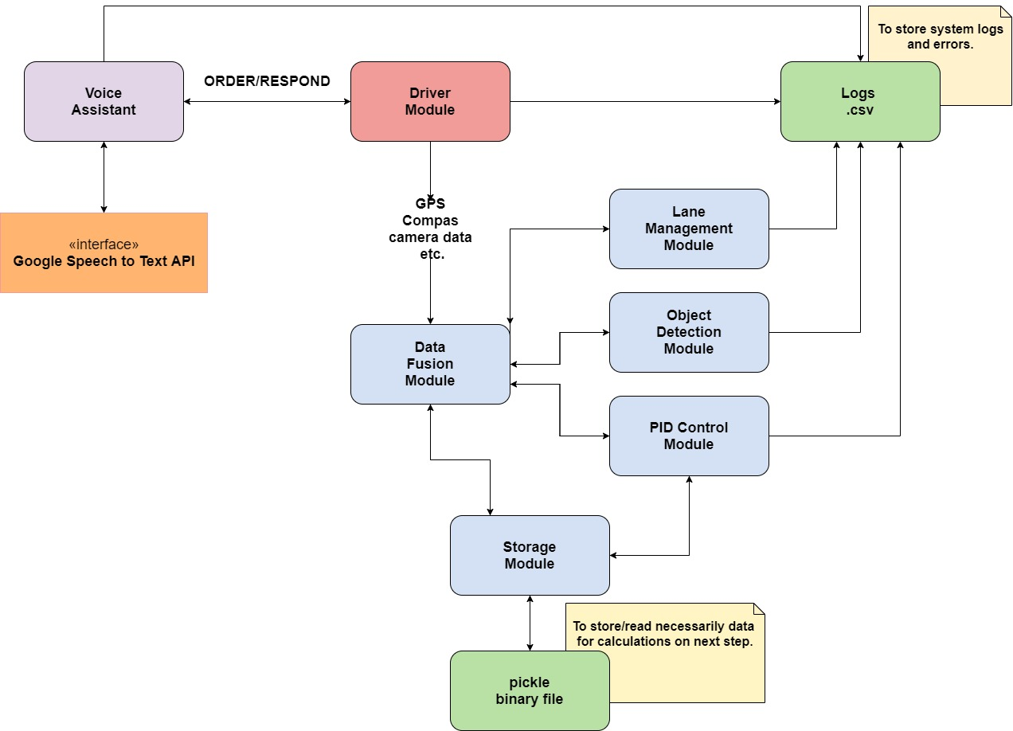
System Architecture

Slide 7

Drive Module
Takes data from Webots simulation to allocate between the modules.
Provides parallel processing between the voice assistant and the autonomous car.

Slide 8
Data Fusion Module
Main purpose is deciding car’s action with the results of all modules as changing to which lane or the lane change completed successfully or not.

Slide 9

Object Recognition Module
Recognizes objects with cameras
Finds distance to them with the radar distance sensors. Sends results to Data Fusion Module.

Slide 10

Lane Management Module
It’s responsible of finding lines on the road with image processing by the help of OpenCV and Numpy. And finds center of the lane to check if we following lane center correctly.

Slide 11
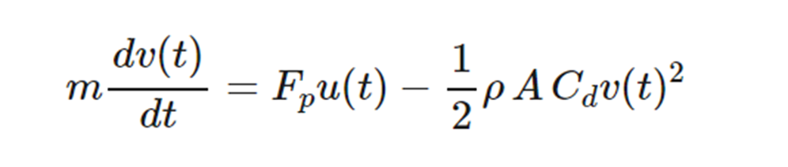
PID Control Module
Speed Control with momentum balance formula.
Cd = drag coefficient
rho = air density (kg/m^3)
A = cross-sectional area (m^2)
Fp = thrust parameter (N/%pedal)
m = vehicle mass (kg)

Slide 12
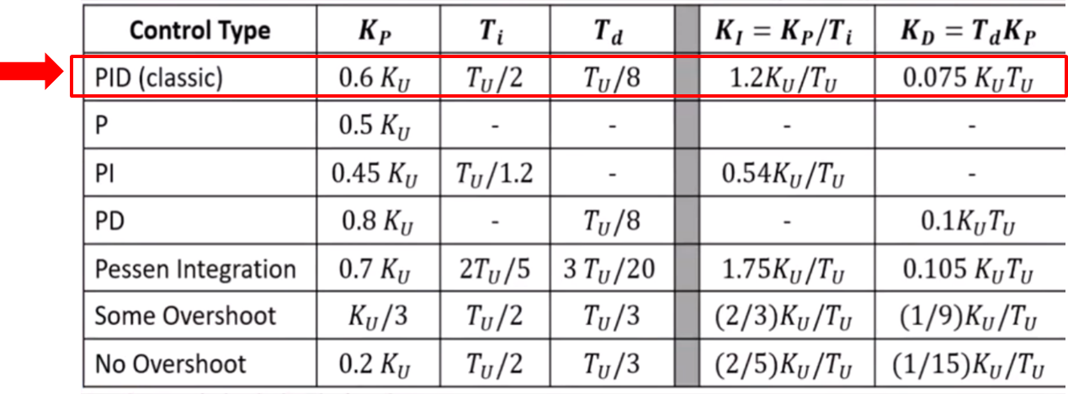
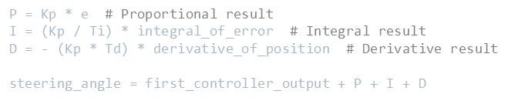
PID Control Module
Position Control with using the Ziegler-Nichols Method.

Slide 13
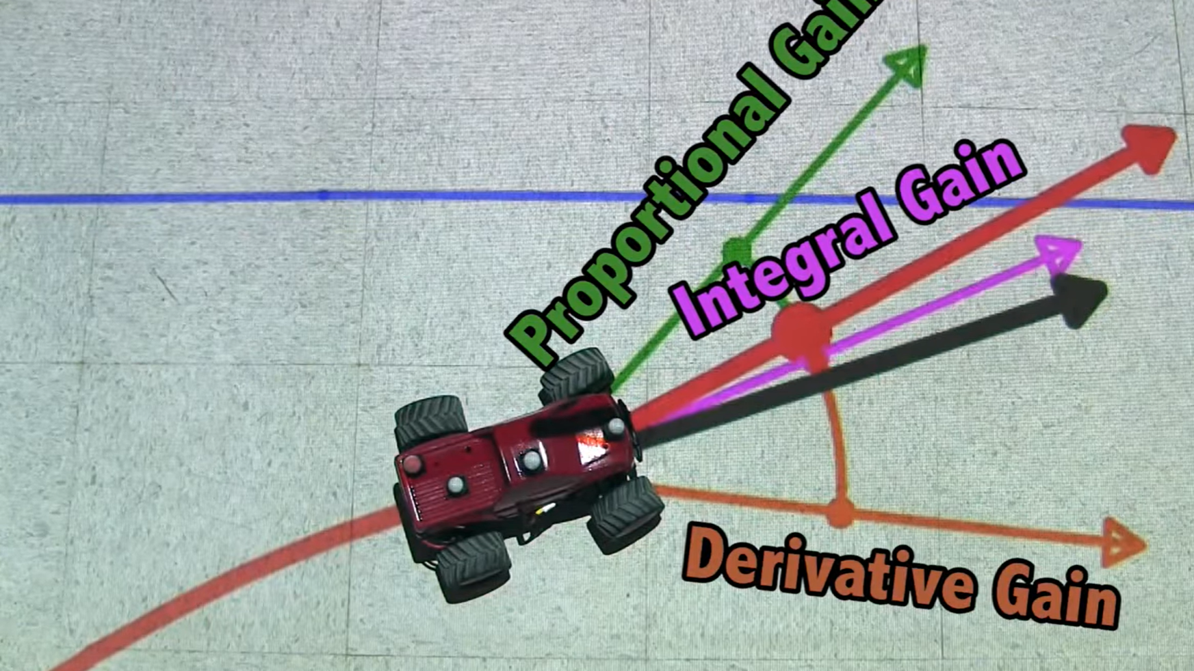
PID Control Module

Slide 14
Storage Module
This module for storing data for iterations in PID and Data Fusion.

Slide 15
Voice Assistant Module
User can give orders to AutoCar with this module. For changing lane, speeding up, slowing down.

Slide 16
Logs
To store data and error logs csv files has been used.

Slide 17
Results and Conclusions
Autonomous Car System can:
Detect lanes and follow the lane
Recognize Objects and avoid them
Change its lane according to emergency or voice order
Change speed of the car with voice order

Slide 18
References
For more information about PID and PID on Self Driving Cars: https://www.youtube.com/watch?v=n829SwSUZ_c https://www.youtube.com/watch?v=4Y7zG48uHRo https://www.youtube.com/watch?v=k46nCvOBllA

Slide 19
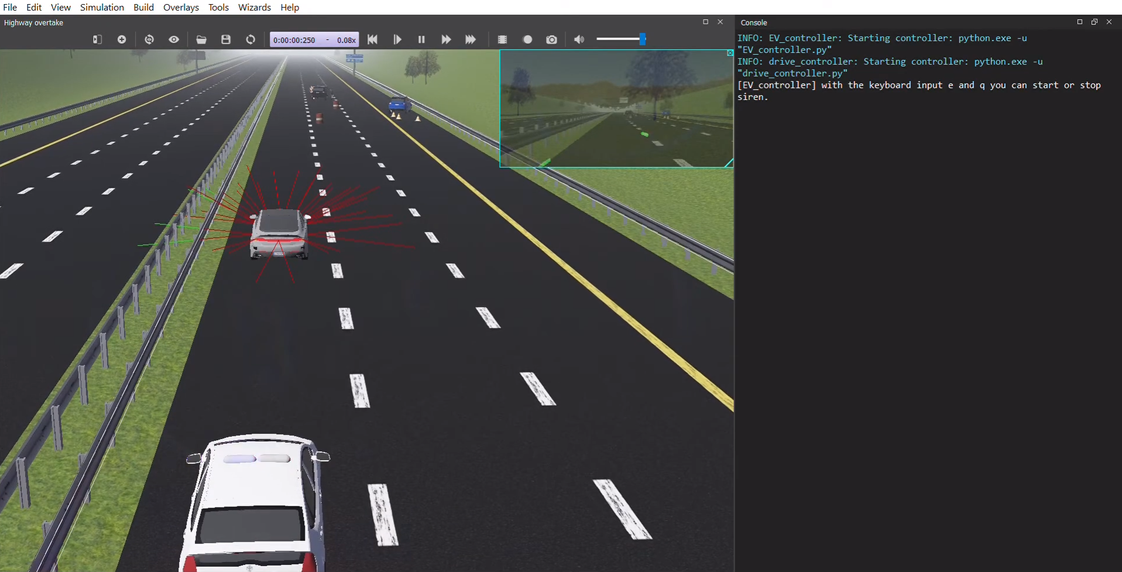
Demo
Center camera view
Output Screen
Distance Sensor Rays
Emergency Vehicle

Slide 20
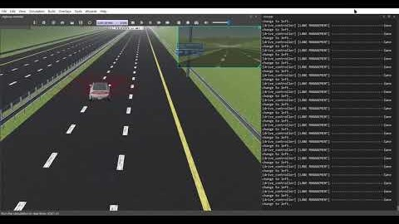
Demo

Slide 21
Thank you for listening

